Slide 1
Lesson 2
Development tools
Lecture adapted from Murach’s MySQL Textbooks

Slide 2
Objectives
Start or stop the MySQL database server.
Use MySQL Workbench to do any of the following:
Create a database connection
Navigate through the objects of a database
View the column definitions for a table
View the data for a table
Edit the column definitions for a table
Use MySQL Workbench to enter, run, open, and save SQL statements and scripts.
Use the MySQL Reference Manual to look up information about SQL statements.
Use MySQL Monitor to run a SQL statement.

Slide 3
Objectives (continued)
Knowledge
Briefly describe the function of each of these client tools: the MySQL Monitor, MySQL Workbench, and the MySQL Reference Manual.

Slide 4
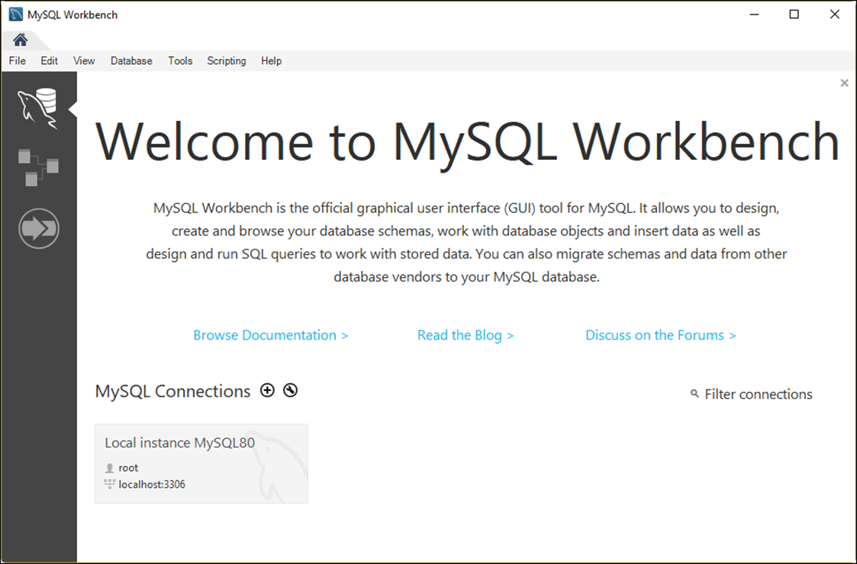
The Home page of MySQL Workbench

Slide 5
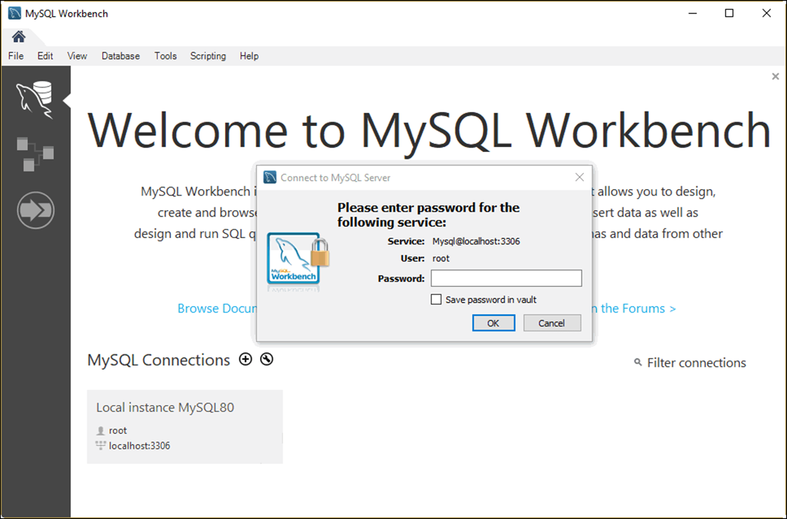
The dialog box for opening database connections

Slide 6
How to connect as the root user
1. Click the stored connection named “Local instance MySQL80”.
2. Enter a password if prompted.
How to specify your own connection parameters
1. Right-click the connection and select the Edit Connection item.
2. Enter the connection parameters and click the Close button.
How to create a new connection
1. Click the icon to the right of MySQL Connections.
2. Enter the connection parameters and click the OK button.

Slide 7
How to save a password
Check the “Save password in vault” option when prompted for your password.
How to clear a password
Right-click the connection.
Select the Edit Connection item.
Click the Clear button for the password.
Click the Close button.

Slide 8
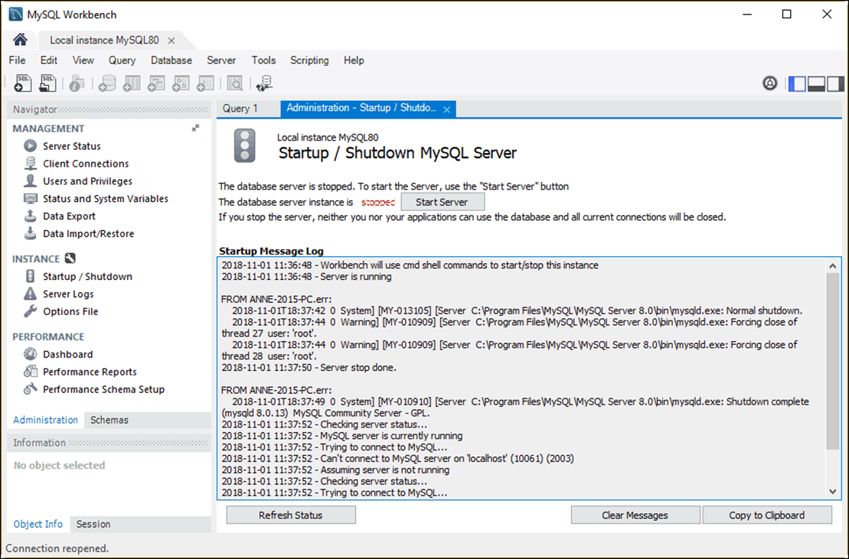
The Startup/Shutdown option of MySQL Workbench

Slide 9
How to stop and start the database server
Display the Welcome tab of the MySQL Workbench Home page.
Click on the MySQL80 connection and enter a password if prompted.
In the Navigator window, select the Startup/Shutdown option.
Click the Stop Server button to stop the database server. Or, click the Start Server button to start it.
Note
After you install MySQL, the database server usually starts automatically each time you start your computer.

Slide 10
Sample Database

Slide 11
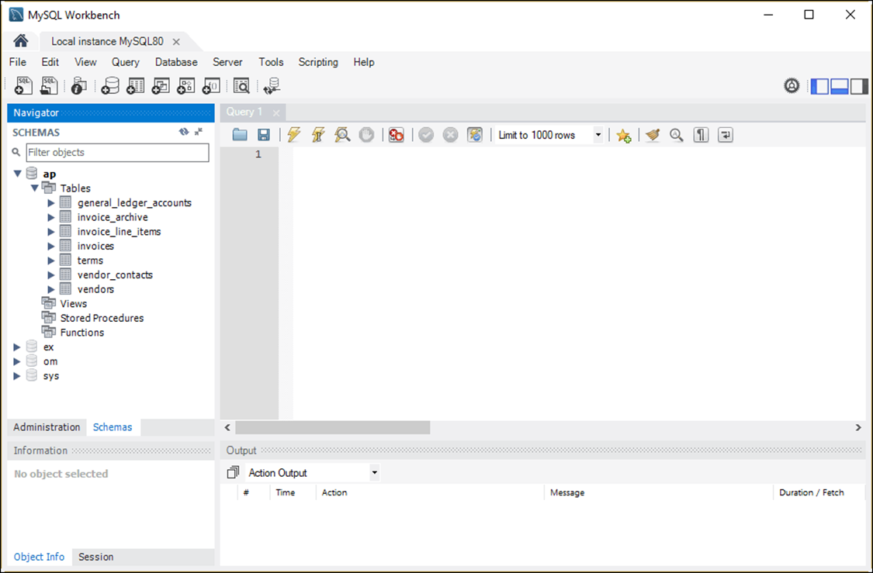
The tables available for the AP database

Slide 12
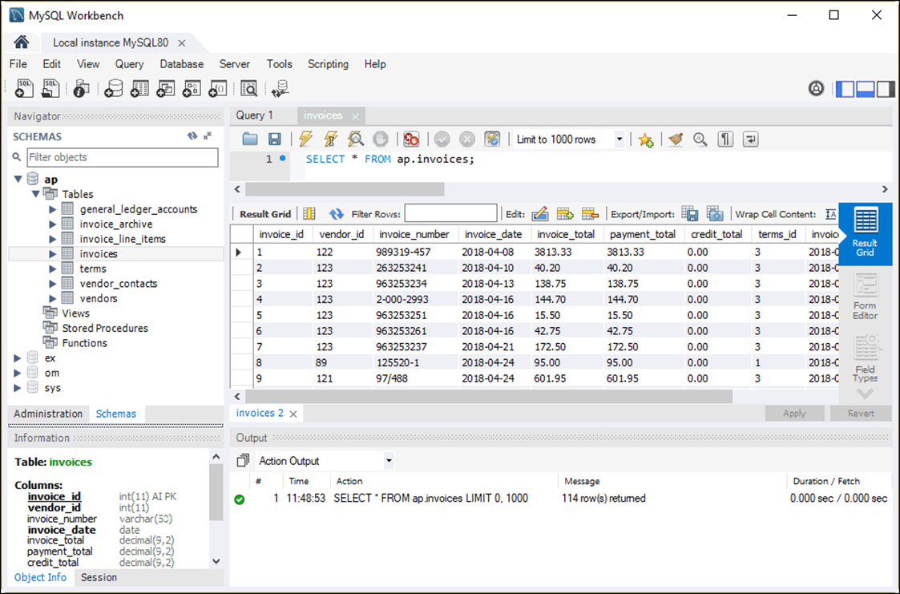
The data for the Invoices table in a Result grid

Slide 13
How to view the data for a table
Right-click the table in the Schemas section of the Navigator window.
Select the Select Rows - Limit 1000 command to display it in a Result grid.
How to edit the data for a table
View the data.
Use the buttons at the top of the Result grid to insert, update, and delete rows.
Click the Apply button at the bottom of the tab to apply the changes.

Slide 14
How to view the column definitions
Right-click the table name in the Navigator window and select the Alter Table command.
Select the Columns tab at the bottom of the window that’s displayed.
How to edit the column definitions
View the column definitions.
Use the resulting window to add new columns and modify and delete existing columns.

Slide 15
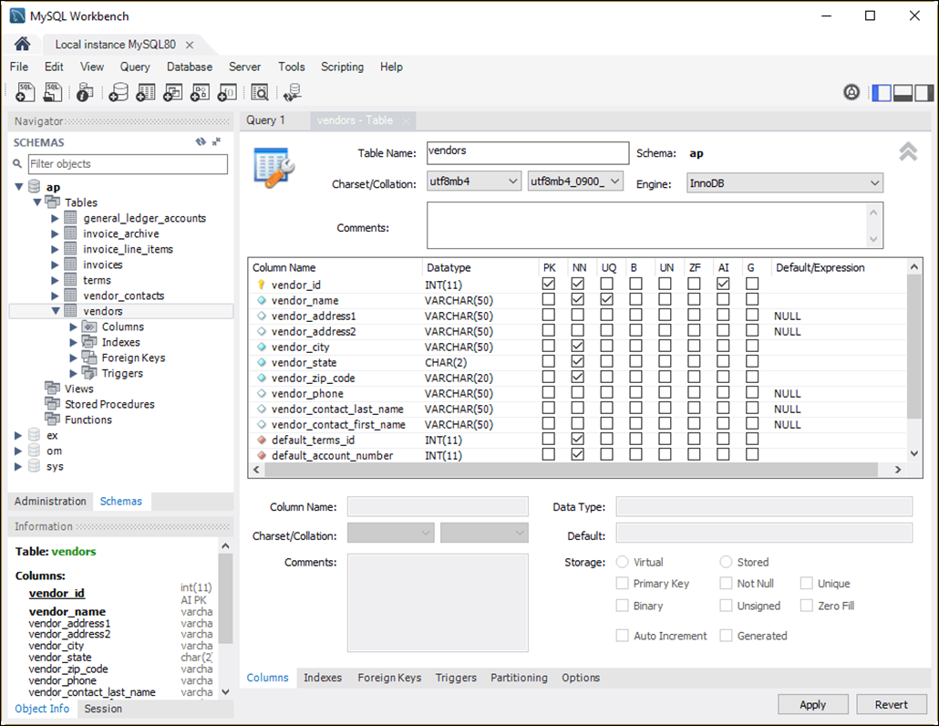
The column definitions for the Vendors table

Slide 16
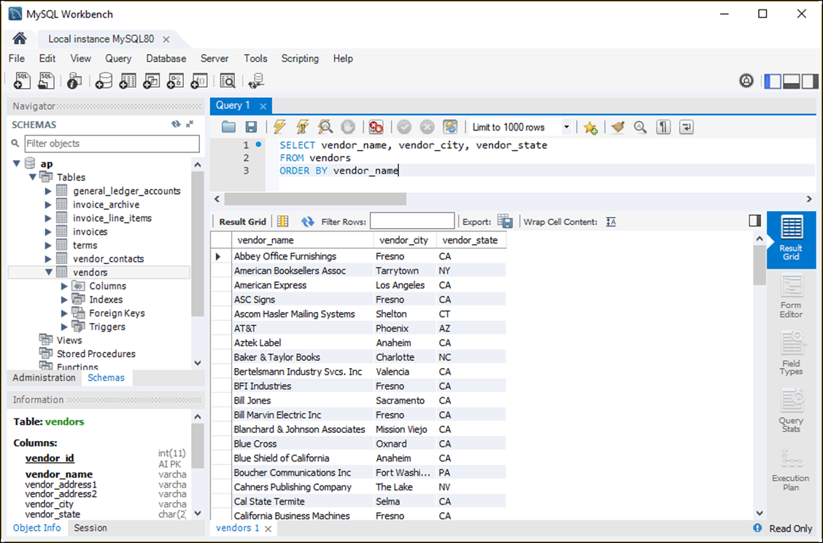
A SELECT statement and its results

Slide 17
How to enter a SQL statement
Press Ctrl+T or click the Create New SQL Tab button in the SQL Editor toolbar to open a new code editor tab.
Double-click a database in the Schemas tab of the Navigator window to select it.
Type the SQL statement into the SQL editor.
How to execute a SQL statement
Press Ctrl+Enter or click the Execute Current Statement button in the SQL Editor toolbar.
If the statement retrieves data, the data is displayed in a Result grid.

Slide 18
How to use a snippet
1. To display any category of snippets, select the category from the drop-down list at the top of the Snippets tab.
2. Select the snippet and then click the Insert Snippet button at the top of the Snippets tab.
3. Edit the snippet code so it’s appropriate for your SQL statement.
How to replace code with a snippet
1. Select the code.
2. Select the snippet you want to replace the code with.
3. Click the Replace Current Text button.

Slide 19
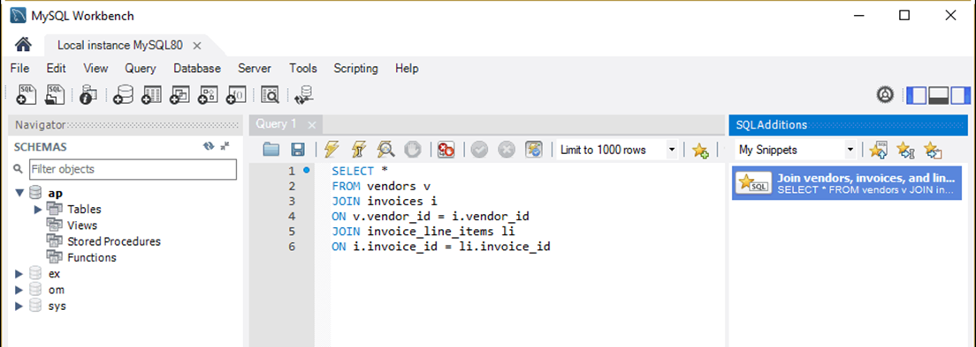
The SQL Additions tab with a snippet created by a user

Slide 20
How to create your own snippet
1. Enter the code for the snippet into a SQL editor tab.
2. Select the category where you want to save the snippet.
3. Click the Save Snippet button in the SQL Editor toolbar, and enter a name for the snippet.
How to delete a snippet
1. Right-click the snippet in the Snippets tab.
2. Select the Delete Snippet item.

Slide 21
Common causes of errors
Having the wrong database selected
Misspelling the name of a table or column
Misspelling a keyword
Omitting the closing quotation mark for a character string

Slide 22
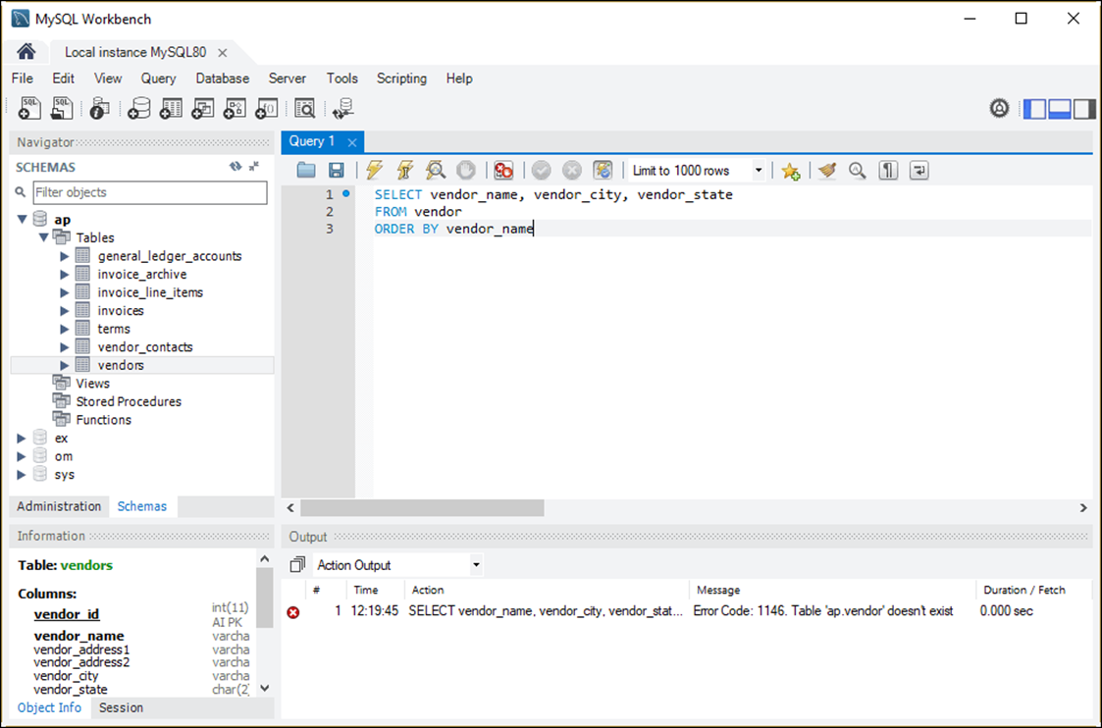
How to handle syntax errors

Slide 23
How to open a SQL script
Click the Open SQL Script File button in the SQL Editor toolbar or press the Ctrl+Shift+O keys.
Use the Open SQL Script dialog box to locate and open the SQL script.
How to switch between open files
Select the appropriate tab.
How to cut, copy, and paste code
Use the standard techniques.

Slide 24
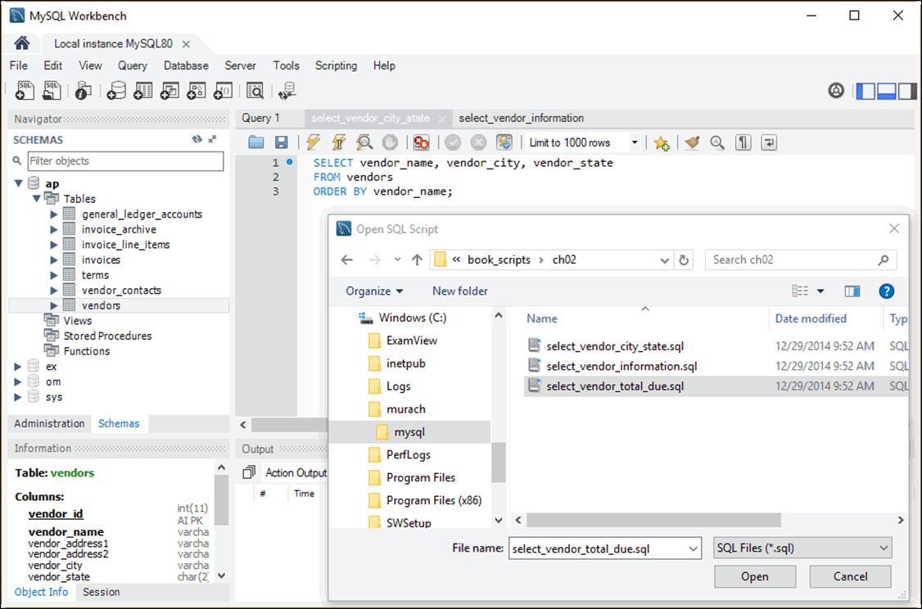
The Open SQL Script dialog box

Slide 25
How to save a new SQL script
Click the Save button in the SQL Editor toolbar or press Ctrl+S.
Use the Save SQL Script dialog box to specify a location and name for the file.
How to save a modified script to a new file
Press the Ctrl+Shift+S keys or select the File→Save Script As command.
Use the Save SQL Script dialog box to specify a location and name for the file.

Slide 26
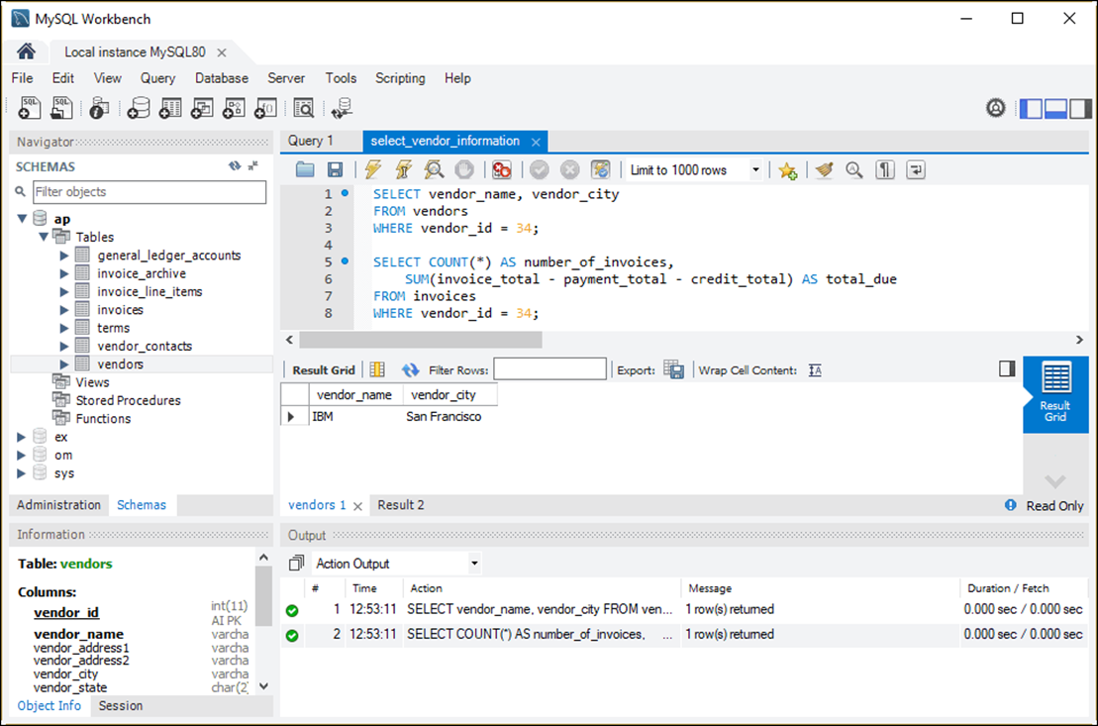
A SQL script and its results

Slide 27
How to run an entire script
Press the Ctrl+Shift+Enter keys or click the Execute SQL Script button.
How to run on statement within a script
1. Move the insertion point into the statement you want to execute.
2. Press the Ctrl+Enter keys or click the Execute Current Statement button.

Slide 28
How to run two or more statements in a script
Select the statements you want to execute.
Press the Ctrl+Shift+Enter keys or click the Execute SQL Script button.
Notes
The results of each statement that returns data are displayed in a separate Result grid.
If a script contains more than one statement, you must code a semicolon at the end of each statement.

Slide 29
The web address for the MySQL 8.0 Reference Manual
https://dev.mysql.com/doc/refman/8.0/en/

Slide 30
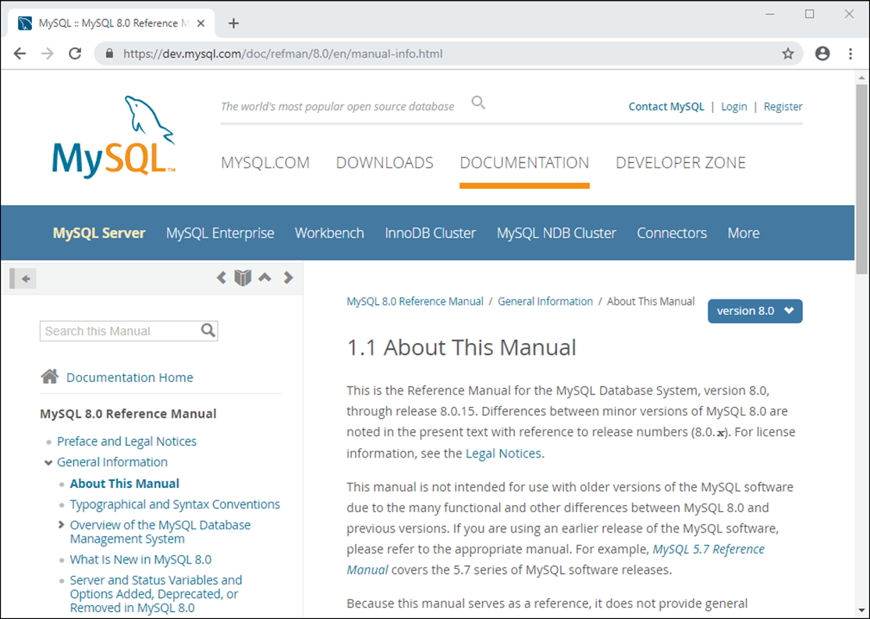
A web page from the MySQL Reference Manual

Slide 31
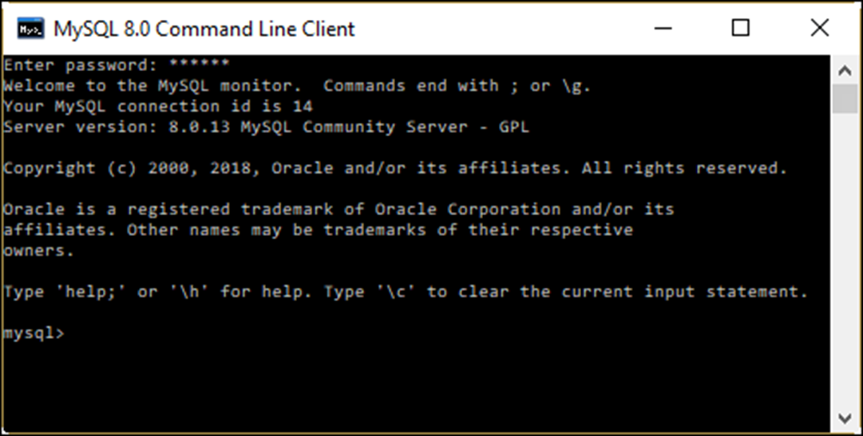
The MySQL Command Line Client in Windows

Slide 32
How to start the MySQL Command Line Client from the Windows Start menu
Start→All Programs→MySQL→MySQL Server 8.0→ MySQL 8.0 Command Line Client
How to start the MySQL Command Line Client from the Windows Command Prompt window
cd \Program Files\MySQL\MySQL Server 8.0\bin
mysql –u root -p
How to start the MySQL Command Line Client from a macOS Terminal window
cd /usr/local/mysql/bin
./mysql –u root -p

Slide 33
The syntax of the mysql command
mysql –h hostname –u username –p
Examples of the mysql command
mysql –u ap_tester -p
mysql –h localhost –u root –p
mysql –h murach.com –u ap_tester –p
How to exit the MySQL Command Line Client
mysql>exit;

Slide 34
How to list the names of all databases managed by the server
mysql> show databases;
+--------------------+
| Database |
+--------------------+
| ap |
| ex |
| information_schema |
| mysql |
| om |
| performance_schema |
| sys |
+--------------------+
7 rows in set (0.00 sec)

Slide 35
How to select a database for use
mysql> use ap;
Database changed
How to select data from a database
mysql> select vendor_name from vendors limit 5;
+------------------------------+
| vendor_name |
+------------------------------+
| Abbey Office Furnishings |
| American Booksellers Assoc |
| American Express |
| ASC Signs |
| Ascom Hasler Mailing Systems |
+------------------------------+
5 rows in set (0.00 sec)

